Slide 1
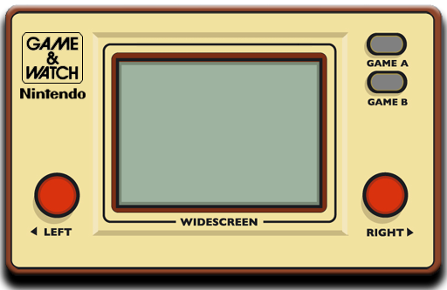


Slide 2

Let’s go! WAHOOO!!
Introduction
Objective
Methodology
Analysis
USA
Europe
Japan
Insights
Questions?

Slide 3

Introduction
Methodology
Analysis
Insights

Slide 4


About the video game industry:
The video game industry is a $120BN market
150 million Americans play video games
Ages 16-35 spend as much time playing video games as outdoor activities
Video game marketing’s budget is much larger than cinema’s advertising budget

Slide 5

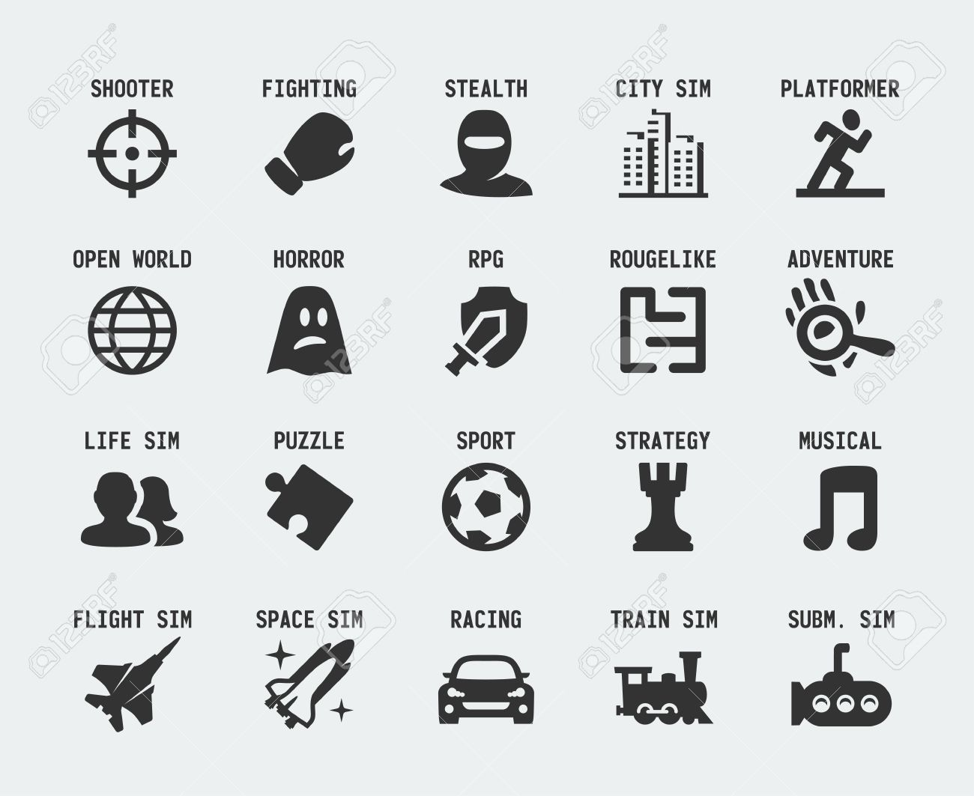
Determine which genre performs the best in each region?

Slide 6

Introduction
Methodology
Analysis
Insights

Slide 7


Scrape data needed for analysis:
http://www.vgchartz.com/yearly/2006/USA/

Slide 8
Scraped data on console games except PC & Mobile
Country
Video game name
Rank
Year released
Genre
Company
Yearly sales
Total sales
Total Sales determine how popular the genre is

Slide 9
Notes:
We want to query the genre, as well as the position of the videogame which is based on total sales.

Slide 10

Introduction
Methodology
Analysis
Insights

Slide 11

Popular Video Game Genre
Japan | Europe | USA
Notes:
Popular genres in its respective region:
USA: sports, shooter, platform -> 3 of the most popular genres in USA
Japan: strategy, role-playing, puzzle, party, misc, fighting, adventure, action -> 8 of the most popular genres in Japan.
Europe: simulation, racing, action-adventure -> 3 of the most popular genres in Europe

Slide 12
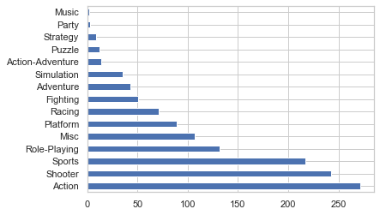
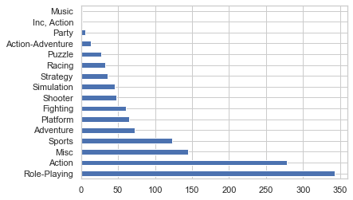
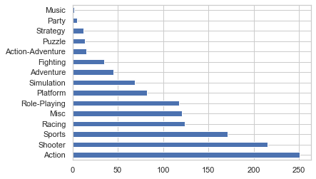
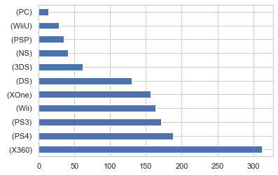
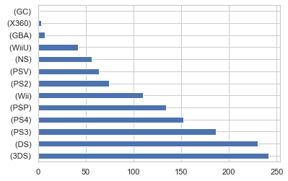
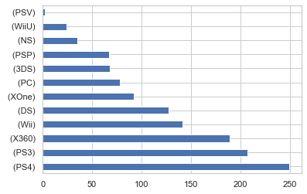
Distribution of Genres & Consoles
USA
Japan
Europe

Slide 13
Distribution Video Game Genre
USA | Europe | Japan
Notes:
USA, Europe and Japan are equally distributed in some genres such as action.
Japan has heavier interest into role-playing genre.

Slide 14

Overall USA Genres Breakdown
Notes:
Top 3 Genres in the USA
Action genre video games contribute up to 21% (272 video games) of the 1300 video games.
Shooter genre video games contribute up to 19% (243 video games) of the 1300 video games..
Sports genre video games contribute up to 17% (217 video games) of the 1300 video games.
Role-playing games contribute up to 10% (132 video games) of the 1300 video games.

Slide 15

Overall EU Genres Breakdown
Notes:
Top 3 Genres in Europe
Action genre video games contribute up to 20% (251 video games) of the 1300 video games.
Shooter genre video games contribute up to 17% (215 video games) of the 1300 video games..
Sports genre video games contribute up to 13% (171 video games) of the 1300 video games.
Racing games contribute up to 9% (124 video games) of the 1300 video games.

Slide 16

Overall Japan Genres Breakdown
Notes:
Top 3 Genres in Japan
Role-Playing contribute up to 26% (343 video games) of the 1300 video games.
Action genre contribute up to 22% (278 video games) of the 1300 video games..
Misc genre contribute up to 11% (145 video games) of the 1300 video games.
Sports contribute up to 10% (123 video games) of the 1300 video games.

Slide 17



 | USA | Europe | Japan | Which country has the best performing genre?
Action | 272 | 251 | 278 | Japan
Action-Adventure | 14 | 15 | 13 | Europe
Adventure | 43 | 45 | 73 | Europe
Fighting | 51 | 35 | 61 | Japan
Inc, Action | 0 | 0 | 2 | Japan
Misc | 107 | 121 | 145 | Japan
Music | 2 | 2 | 1 | USA,EU
Party | 3 | 5 | 6 | Japan
Platform | 89 | 82 | 65 | USA
Puzzle | 12 | 14 | 27 | Japan
Racing | 71 | 124 | 33 | Europe
Role-Playing | 132 | 118 | 343 | Japan
Shooter | 243 | 215 | 48 | USA
Simulation | 35 | 69 | 46 | Europe
Sports | 217 | 171 | 123 | USA
Strategy | 9 | 12 | 36 | Japan
Which genre best by region? | Action | Action | Role-playing
Notes:
Which country has the best performing genre?
Japan outperforms in:
Action
Fighting
Inc Action
Misc
Party
Puzzle
Role-playing
Strategy
USA outperforms in:
USA
Platform
Shooter
Sports
Europe outperforms in:
Action Adventure
Adventure
Racing
Simulation
Popular genre based on region?
USA
Action Shooter Sports
Europe
Action Shooter Sports
Japan
Role-playing Action Misc

Slide 18

Introduction
Methodology
Analysis
Insights

Slide 19


Which genre performs the best?
Which genre in each region is most popular?
Which country has the best performing genre?
Which console performs the best?

Slide 20

Which genre performs the best?
Action Genre

Slide 21
Which genre in each region is most popular?
Which genre performs the best?
Which country has the best performing genre?

Slide 22
Which genre performs the best?
Action Genre
Which genre in each region is most popular?
Japan | Action
Europe | Action-Adventure
Europe | Adventure
Japan | Fighting
Japan | Inc, Action
Japan | Misc
USA,EU | Music
Japan | Party
USA | Platform
Japan | Puzzle
Europe | Racing
Japan | Role-Playing
USA | Shooter
Europe | Simulation
USA | Sports
Japan | Strategy

Slide 23
Which genre in each region is most popular?
Which genre performs the best?
Which country has the best performing genre?

Slide 24
Which genre performs the best?
Action Genre
Which genre in each region is most popular?
3. Which country has the best performing genre?
Japan | Action
Europe | Action-Adventure
Europe | Adventure
Japan | Fighting
Japan | Inc, Action
Japan | Misc
USA,EU | Music
Japan | Party
USA | Platform
Japan | Puzzle
Europe | Racing
Japan | Role-Playing
USA | Shooter
Europe | Simulation
USA | Sports
Japan | Strategy
USA | Action
Europe | Action
Japan | Roleplaying

Slide 25
Which country has the best performing genre?
Which console performs the best per region?
USA | Action
Europe | Action
Japan | Roleplaying
USA
Japan
Europe

Slide 26
USA, and Europe exhibit share a strong interest in these 3 genres: action, shooter, and sport.
Japan is interested in these top 3 genres: role-playing, action, and miscellaneous.
USA, Europe, and Japan have a strong interest in the action genre.
USA : Xbox 360 , PS4, PS3
Japan : 3DS, DS, PS4.
Europe : PS4, PS3, XBOX360
Handheld consoles are better in Japan which could explain the genre rating disparity.
Determine which companies are performing the best and which genre they have been focusing on?

Slide 28
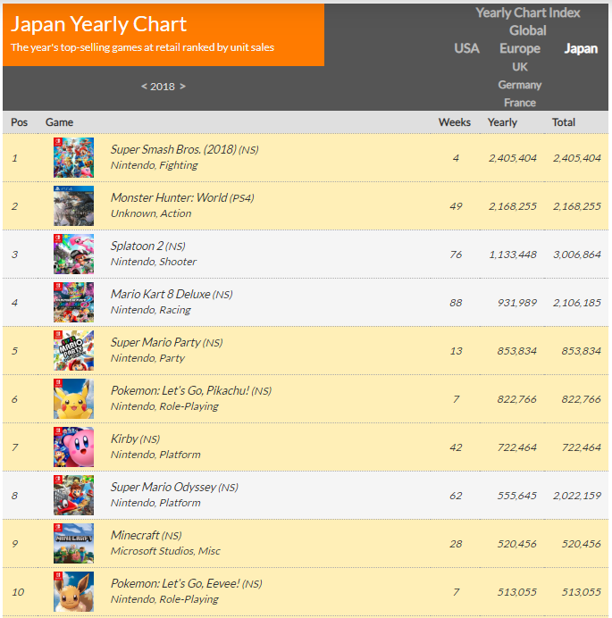
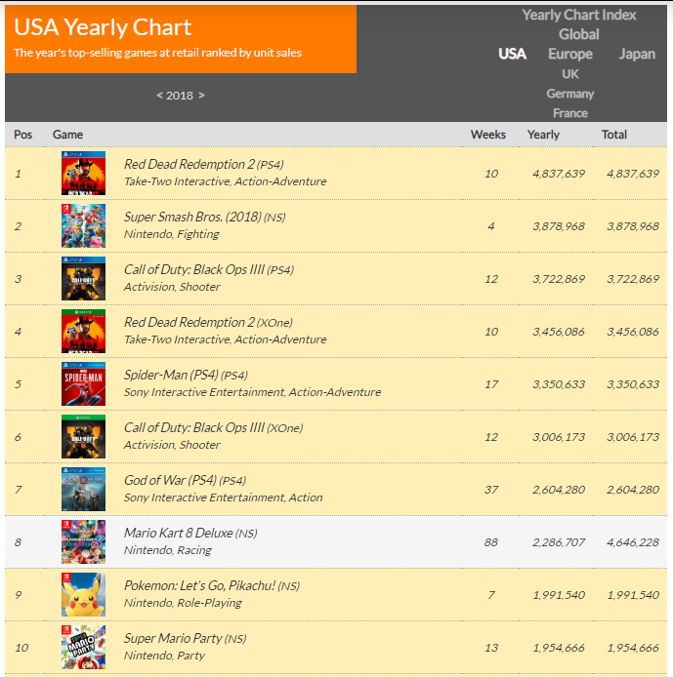
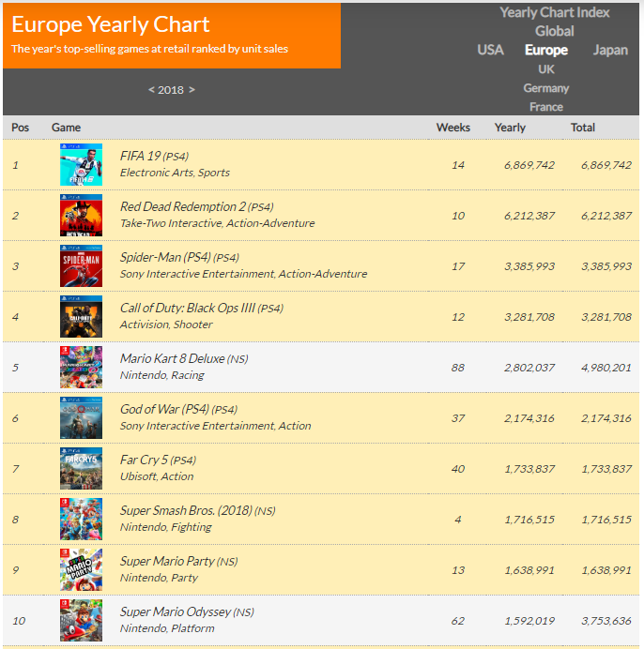
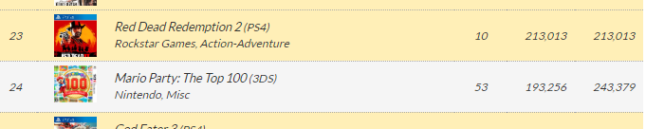

Slide 29
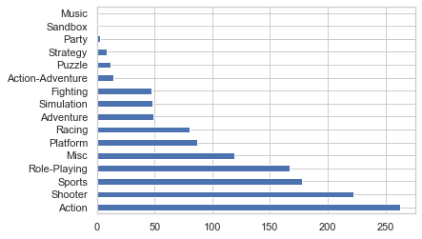
Genre Count
Global
Japan
USA
Europe

Slide 30
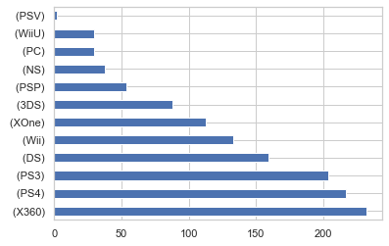
Console Games Count
Global
Japan
USA
Europe

Slide 31
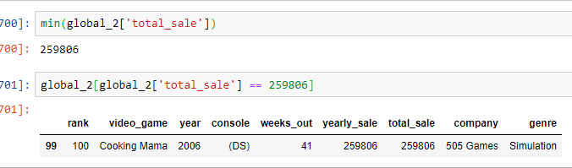
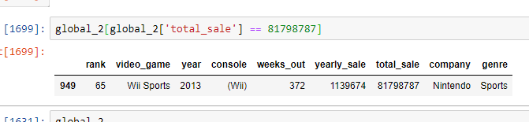
Global
USA
Japan
Europe

